Slide 1
Canadian Heritage
Code for …
History isn’t boring
Notes:
I was thinking we could banter for an introduction
SC is the teacher, GH is the student
SC: Did you experience any THAT’s Unbelievable or WHAT? Moments during your research on Canadian Mining?
GH: Yes. Did you know in the late 1800s, some mothers and fathers took their children with them to work in the mines, perhaps carrying small rocks onto rock carriers. It was dark, scary and dangerous in those mines. I’m a students helper in one of our kindergarten classes and they can’t even open a milk carton or tie their shoes.
SC: That’s horrible!
GH: Yeah, that was just insane! How could that have been allowed? Thank goodness laws and child protection measures were started.
THIS student, Alexis had the top project in Simcoe County last year. Her personal connections took her high level of research and writing into a truly interesting space. Her classmates, teachers and judges could see her passion … stereotypically, one might not expect a girl to do a project on Mining. Allowing students to put their mark, their personality made History come alive … very FAR from boring.

Slide 2
Heritage Fair
Shaughna Crew, Events Planner Simcoe County Museum
Greg Harris, Teacher Librarian
Ardagh Bluffs PS, Simcoe County DSB
Our Goals For You:
You know why Heritage Fair matters
You know how to start HF @ work
You have contacts
Notes:
SC …. Something like
Our goals for you are …

Slide 3
Heritage Fair
BIASED?
Yes,
Yes we are.
Notes:
Greg tells why Heritage Fair matters to the teacher point of view …
I have become a better teacher because I have helped students make connections and become better researchers. I have helped my teaching colleagues become better teachers and without a doubt they have made me better too.
I have kids at my school that look forward to taking part in research, inquiry, building projects, presenting each year.
I have teaching colleagues that say this is brilliant and essential.
I have a wonderful local museum colleague who helps anybody out with implementing and taking part at the school and county level … Shaughna Crew
Shaughna tells why Heritage Fair matters to her from her point of view

Slide 4
We are not alone in this bias…
From the Top
Very good stuff is happening here!
From the Bottom
Notes:
Shaughna introduces first clip
Show Heritage Fair clip and stop just when Axworthy starts to talk at 2:10
Greg introduces Mason clip … All the student and adult clips from here in are first takes, no edits. The students, teachers and superintendent were asked to take part with only the briefest heads up, and that was, I’m going to ask you a few Qns about your Heritage Fair experiences.
Mason is in Grade 7 and will be talking about his work in Grades 5 and 6.
Without any pre-prompt, Mason talks about this year … back in September
These clips show engaged students enjoying Canadian Heritage.
They show the potential of students who have choice, support to engage in real historical work … thinking like Historians.

Slide 5
The Project Parts …
Deconstruct
Display … Why it matters
Explanation/Description
Photos, captions, artefacts,
Citations
Higher Order Thinking Question/component
Notes:
Shaughna tells why the Project Board matters, that is Museum space, tech support issues, electrical issues …. #1
Greg tells how a specific board is set up … # 2 – 5
Karyssa’s board

Slide 6
Canadian Heritage
Heritage Fair is Canadian stories
Grades 4 – 8
Higher order thinking
Engaged students
Caring and engaged teachers
Appreciative school community
Great fit with new SS,H&G curriculum
Notes:
More clips …
Elizabeth three clips … all Hockey all the time
Watch how the style of conversation moves from like a 12 year old like girl in like the first clip to the conversation of a driven and successful leader in the third clip
… Hopefully you won’t leave just yet, but When a student tells you they are changing the world, and they clearly have demonstrated that they are doing this … Really you ought to be convinced to give this a go ….
Clearly, I can’t take credit for Elizabeth becoming an activist/recruiter for women’s hockey, but I can see this student’s connection made her a better writer, researcher and presenter …
Shaughna, your child has taken part in Heritage Fair. As a parent, what does this mean to you?
Shaughna, as a passionate employee of the Simcoe County Museum, tell us what this means …

Slide 7
How do I start? A: If your area has Heritage Fair
Go to www.ohhfa.ca , check out the site, Call your local museum Events Planner & Board Curriculum Consultant
Talk with ADMIN and STAFF who are most likely to partner
Start with informal talk to others ...
Add detail, get commitments by year end
Present at Fall staff meeting to all
Notes:
Joanne clip … just jump in
Admin … both clips

Slide 8
B: Unsure about HF in area?
Go to – www.ohhfa.ca, Regions listed, support contacts listed … Lots of info
Contact local museum;
* It can be self-contained within a school
E.g., challenging year of 2012-13
My school planned this as a Curriculum
Activity and was going to hold during
school day and invite parents.
Notes:
This will be followed by screen shots of
Ontario Heritage Fair Association website views …

Slide 9
Ohhfa.ca
Notes:
Click on Regional Fairs on the left sifde tells you what areas in Ontario have Heritage Fairs.

Slide 10
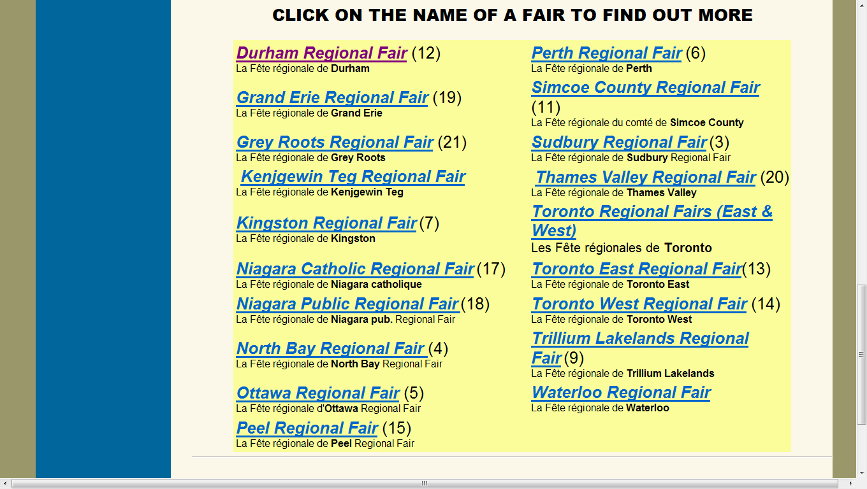
Notes:
Here are the Regions … they have live links to various contacts, info

Slide 11
Teacher Resources, FAQs …
Notes:
Really,
For the slide show part of this, I could have just shown all of the Ontario Heritage Fair slide shows, but I didn’t. You will be better rewarded checking these out fully when you have the time
However, here are a few screen shots to give you an idea …

Slide 12
Another teacher resource
Notes:
A slide show that comprehensively details what you may want to consider when ramping up towards implementation.

Slide 13
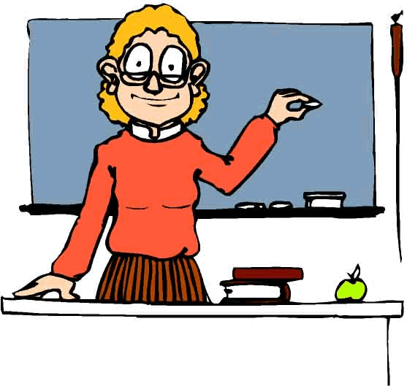
Another teacher resource
ONTARIO HERITAGE FAIRS
INTEGRATING HERITAGE FAIRS INTO YOUR CLASSROOM PROGRAM
Notes:
This is another slide show on the OHFA website.

Slide 14
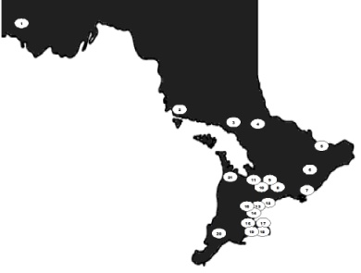
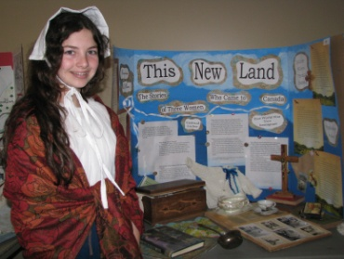
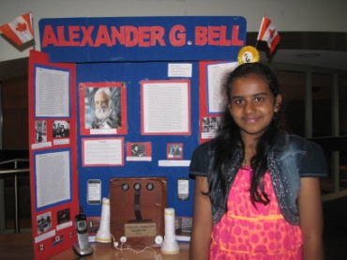
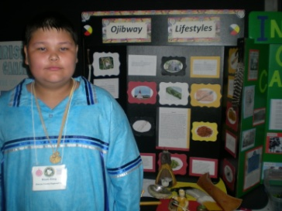
Ontario Heritage Fairs
Linking the Fairs to the 2013 Ontario Curriculum Social Studies 1 to 6 and History and Geography 7 and 8
Notes:
This is a NEW slide show
It does an excellent job of linking Heritage Fair to the new curriculum.
Further, it is a very good resource for sharing with teachers as they implement the curriculum this year OR plan with their implementation next fall.

Slide 15
Notes:
Inquiry, critical thinking in cross curricular ways beyond SS, H and G.
Interpreting and Analysing … marks and comments in reading, writing
Communication … Oral Language, Media Literacy

Slide 16
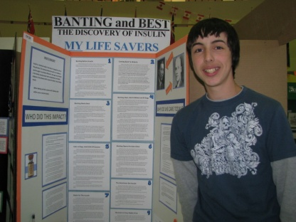
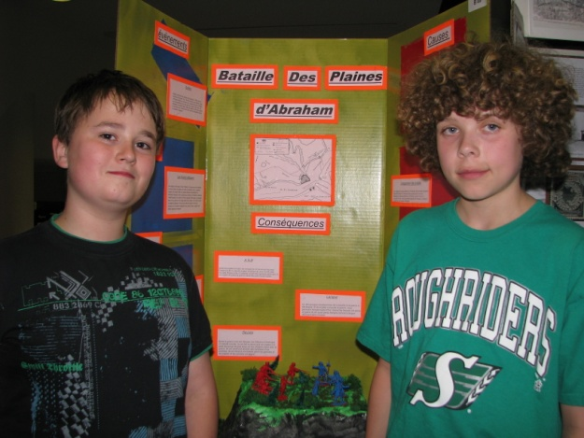
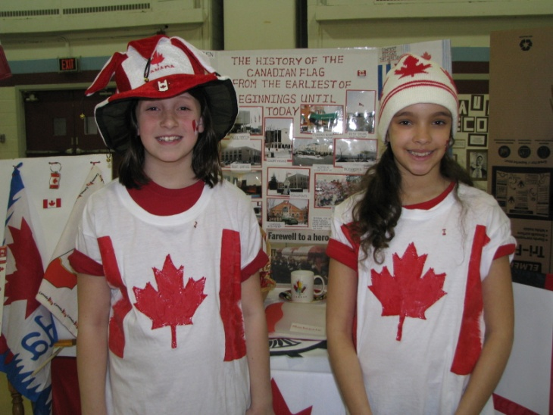
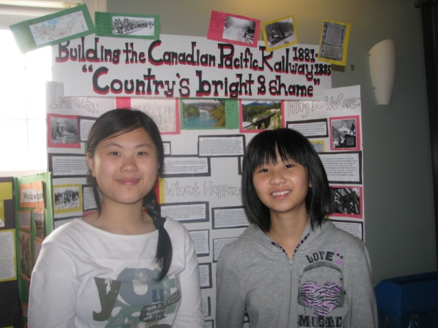
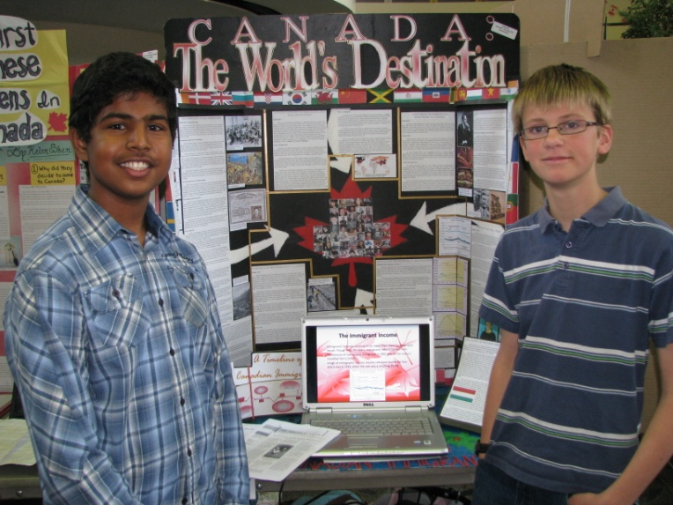
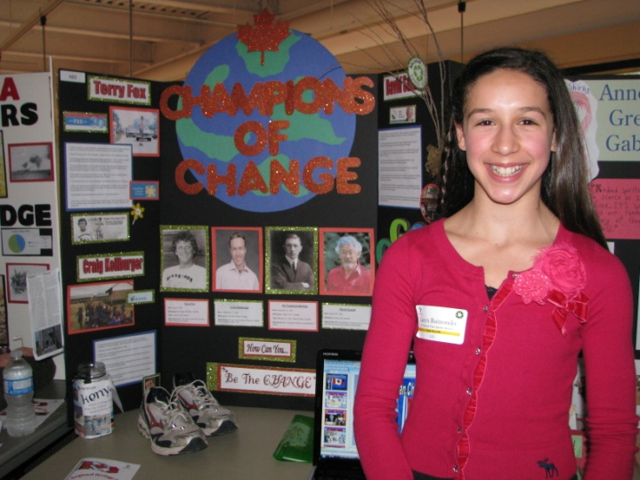
Concepts of Disciplinary Thinking – Making Connections
Significance
Cause and consequence
Continuity and change
Perspective
Patterns and Trends
Interrelationships
Notes:
This is an introductory slide to Disciplinary Thinking.
It is followed by detailed slides of each concept.

Slide 17
Continuity and Change
This concept requires students to determine what has stayed the same and what has changed over a period of time. Continuity and change can be studied with reference to ways of life, political policies, economic practices, relationships with the environment, social values etc.

Slide 18
Role of TL
Just get started with one class teacher
Backwards plan from HF Museum date
Plan teaching/learning, e.g., citations, archive sites, primary & secondary sources, searching skills …
website supports for specific grade/class
Booking student computers in advance, teach norms Bring Own Device
Connect with other TLs, HF support
Notes:
Greg, In my first year of HF, I focused on getting at least one teacher and admin on side AND surviving, meeting deadlines and scrambling to find resources for students.
Reflection was critical. I realized that students had NO idea on how to do an Inquiry beyond searching Google and picking the first three hits. I realized I had to become WAY better at setting ‘check in points’ and in establishing what the student had to be able to demonstrate.
Show Karyssa’s Bieber project … I did, honestly, I did check in with her on her critical thinking questions and basic explanation/definition … Here is the result … comment on photos always showing girls, 1,000,000 people with same name, mis-spelled JB
Not sure who was more embarrased, Karyssa or me … probably her. I still had 1 student of my small group of 7 kids with a county level award and 3 other kids had good projects …
To improve, I focused on defining the projects physical requirements, setting multiple check in points with clearly defined expectations of what the students needed to show me, and I set up a website with folders on specific topics for specific students – I wanted kids to spend more time on the critical thinking than on finding info.
This year I began Google and citing resources lessons, set up online How to Search files and plan to find resources for far fewer students – I am upfront loading how they do this … of course I expect to be a support and will continue to do that.

Slide 19
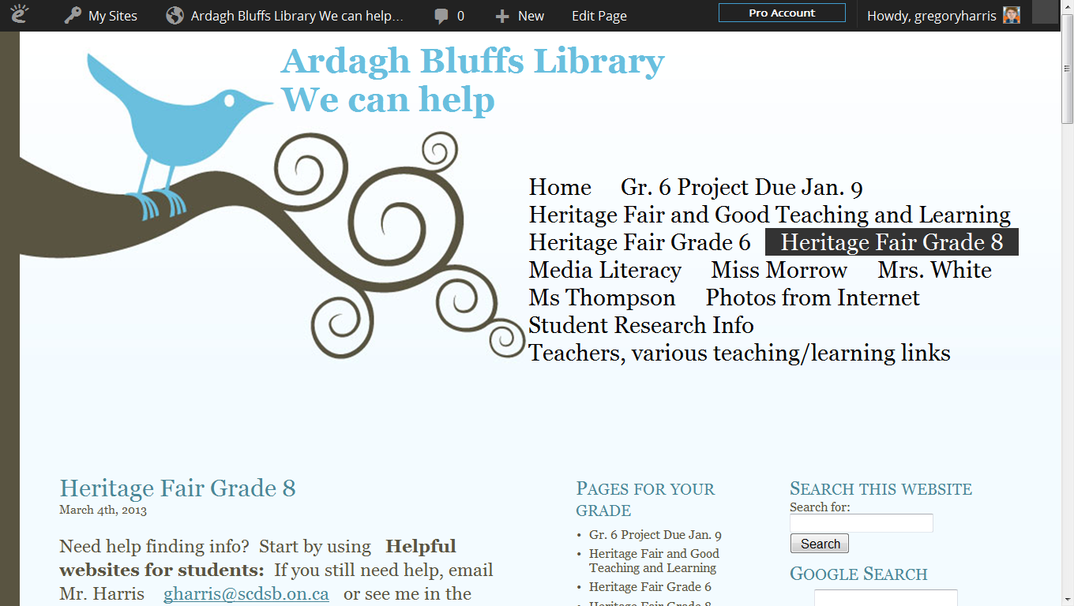

Slide 20
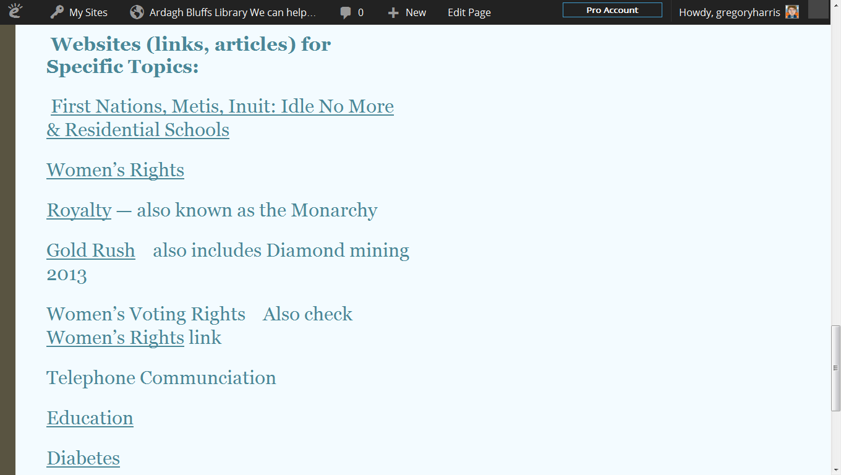
Folder detail
next slide
Notes:
Some of the Grade 8 Folders

Slide 21
Website links
To focus
thinking
Notes:
Kids lost their notes, my notes a lot in Year # 1
So in Year #2, I added in website links and notes online → no more excuses
Yes it was a ridiculous amount of work for me … To cope, I almost completely abandoned many other library jobs such as circulation/shelving to my library helpers and the classroom teachers
KEY was setting up meeting times during classes, during other times of the day which were posted in the hall … kids needs teacher permission and then they came to see me with Qns, notes, etc. It was our Conference times.
Students could also email me to my school email address – knowing my turn around time would be about 24 hours.
This was very well liked by students … and teachers.

Slide 22
Higher Order Thinking Qns
Q-Matrix … next slide
What if …
What should happen now …
What you would change now …
Compare and Contrast
H.O.T. Qns = the most difficult aspect
for teachers and students to grasp
= the most rewarding aspect

Slide 23
Q Matrix Source: Jan, McLellan. Read It…Understand It…Communicate It. Ontario: JEMCON Publishing, 2000.
 | Is | Did | Can | Would | Will | Might
What
Where |  | FACTS |  |  | PREDICT
When
Who
Why |  | SYN-THESIS |  |  | APPLI-CATION
How
Notes:
FACTS help develop QNs to provide Explanations and Descriptions
PREDICT, SYNTHESIS and APPLICATION help develop questions that lead to better discussions.
Examples,
How would Canada be different now, if Louis Riel had been treated as a respected leader and if he hadn’t been executed?
WHY MIGHT the treatment of interred Japanese Canadians during World War 2, lead to better decision making regarding treatment of Canadians from countries Canada is having difficult times with, e.g., Afganistan …
WHO WOULD decide how endangered species like Polar Bears be looked after?

Slide 24
RAN Chart by Tony Stead Reality Checks Pembroke 2006
Process:
Left → Right
Sticky notes for each thoughts goes in What I think I Know
Research → move sticky note to Confirmed or Misconceptions
Add new sticky note to New Information and Wonderings
What I Think I Know | Con- firmed | Miscon- ceptions | New Information | I Wonder
Notes:
RAN means …. Reading and Analysing Non-fiction
Tony Stead’s book was written for K-Grade 5 … if this hasn’t been used in your primary grades and you want to incorporate this into Heritage Fair inquiry work, you should introduce this in the Fall term so students already know how to use it.
It’s like a KWL chart,
The K stands for what you already Know.
The W stands for what you Want to know.
The L stands for what you’ve Learned.
I prefer the RAN, because students may think they KNOW something to be TRUE and it is not. A Whole class KWL is only good when the misconceptions are addressed. For example, many years ago with a grade 1 class, kids thought dinosaurs lived on land, water and air. The true definition only includes animals that lived on land. I had to clear that up. FYI, the air and water dwellers many of us think of as dinosaurs are really classified as flying and swimming reptiles/fish/birds etc.

Slide 25
H.O.T. continued
Consider Bloom’s Taxonomy, (Revised)
Creating -- Generating new ideas, products, or ways of viewing things. Designing, constructing, planning, producing, inventing.
Evaluating -- Justifying a decision or course of action. Checking, hypothesising, critiquing, judging, experimenting, comparing/contrasting
Notes:
The highest two levels of thinking …
Creating and Evaluating
Creating can be generating new ideas, designing, constructing
Evaluating can be comparing and contrasting, critiquing and/or justifying a decision or a course of action that was already undertaken (e.g., MacDonald sets a Head Tax on Chinese immigrants) or one that the student suggests (e.g., Invest in Chinese/English language centres to help Chinese immigrants enjoy and contribute to Canadian society)

Slide 26
Museum supports
People to connect with …
Ontario Archives
www.archives.gov.on.ca
Canadian Archives
www.collectionscanada.gc.ca
Notes:
Shaughna, talk about anything not talked about so far
The next slides are screen shots of Ontario Archives …

Slide 27
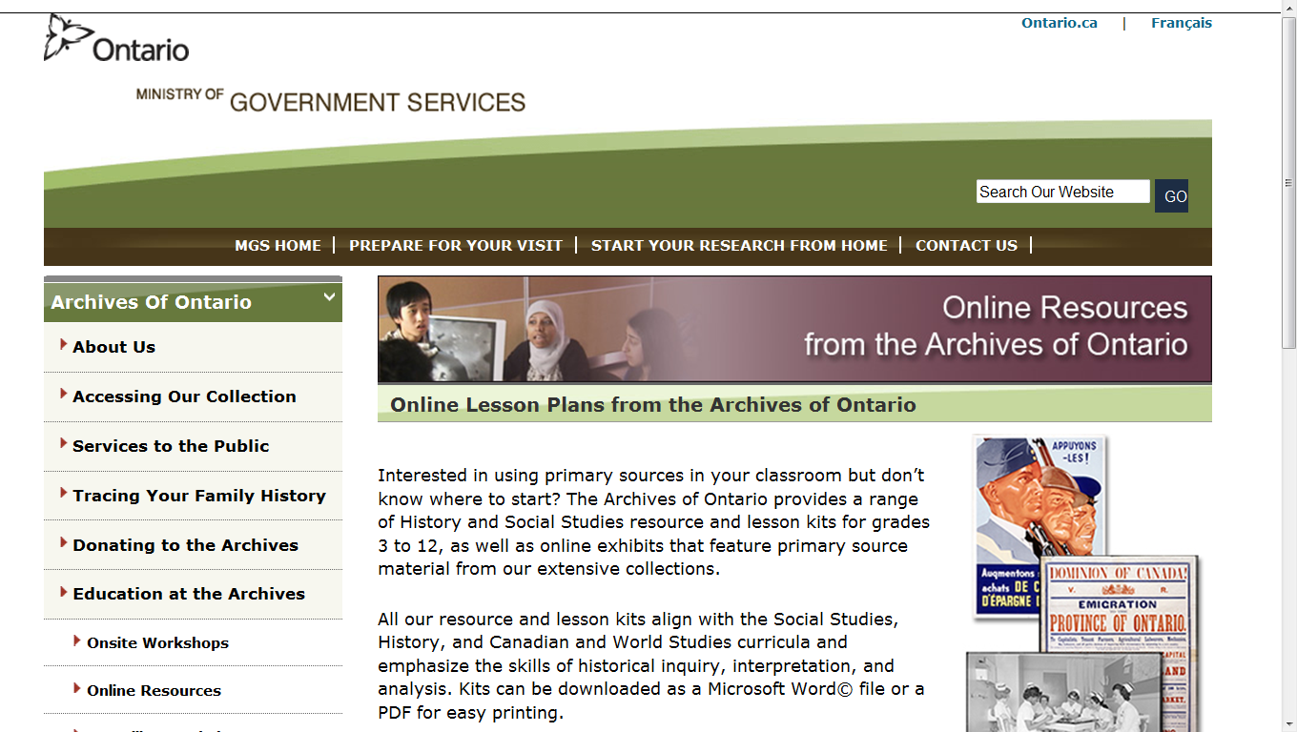
Notes:
Shaughna
Lesson plans and online resources are available at Ontario Archives
MANY of the online resources are PRIMARY resources. More on that in a bit

Slide 28
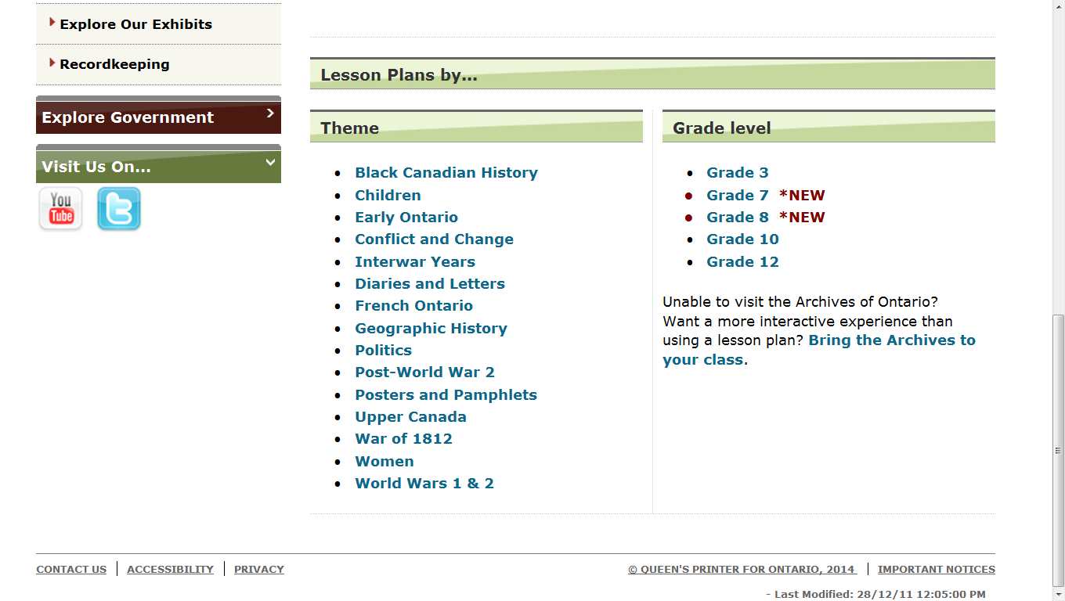
Notes:
Some of the lesson plans available … perhaps a good place to start this February is
In the theme of Black Canadian History … supplemented by picture books, local historians …
Note the Grade 7 and 8 lessons tie into the new Social Studies, History and Geography curriculum.

Slide 29
22 pages on James Bay Treaty
Notes:
This is one example from the Ontario Archives lesson plans.
This is on the James Bay Treaty, a 22 page resource.
It begins with detailing what a Primary and Secondary sources are … AND
Helps guides students to understanding WHY Primary sources are SO VALUABLE and IMPORTANT.
Note the full page goes into many more primary and secondary sources
e.g., Primary sources also include
Diaries
Photographs
Paintings and other art work
Graphs
Maps

Slide 30
Go make history …

